Slide 1
Autonomous Underwater Robotics
Juan Guzman
ASU
Mentor: Shea Ferring

Slide 2
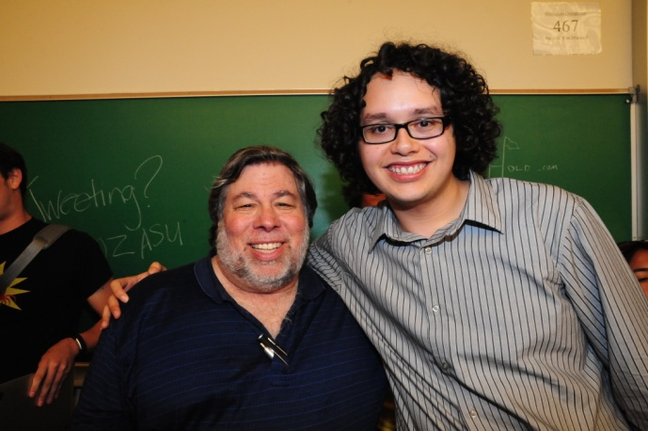
About Me
Name: Juan Guzman
Computer Science major
ASU Senior (graduating December 2012)
Have prior internship with Intel testing validation software
Favorite Quote: “Computers make very fast, very accurate mistakes” – Anonymous

Slide 3
Outline
AUVSI Competition Overview
  Tasks to complete autonomously
What is Autonomy?
Methods
  OpenCV
    Line Detection and Buoy Detection Demo
  ROS
Conclusion

Slide 4

AUVSI
RoboSub Competition
July 17 – 22 in San Diego, CA
Tasks needed to complete
  Follow multiple paths marked by lines
  Touch two Buoys in order by color
  Pass over a PVC gate
  Pick up multiple objects, drop into a bin
  Shoot a projectile at a target
  Pick up small cylinders from cutouts.
The robot will need to do all of this Autonomously
Notes:
Perhaps add some pictures. I know this slide is already crowded but maybe add in animations/pictures that appear and disappear on the right side of the specific tasks.

Slide 5
What do we mean by Autonomous?
“Acting independently or having the freedom to do so”
In previous competitions, robots were tethered to a power source and controlled by human drivers.
In this case, the robot cannot have any human input while completing tasks; all action is the robot acting of its own accord.
The robot will use sensor data and video input to deduce its next logical steps.

Slide 6
Methods - How do we build one of these?
What do we need to build an autonomous robot?
  Hardware
    In addition to the usual sensors and rotors of previous tethered robots
  Software
  Programming

Slide 7
Hardware
This differs from previous Robotics projects in that we will need a capable computer on board.
Things to take into account:
  Processor Power
    Needs to powerful enough to process an incoming video stream in real-time
  Power Consumption
  Size (we have about 4 inches of clearance)

Slide 8
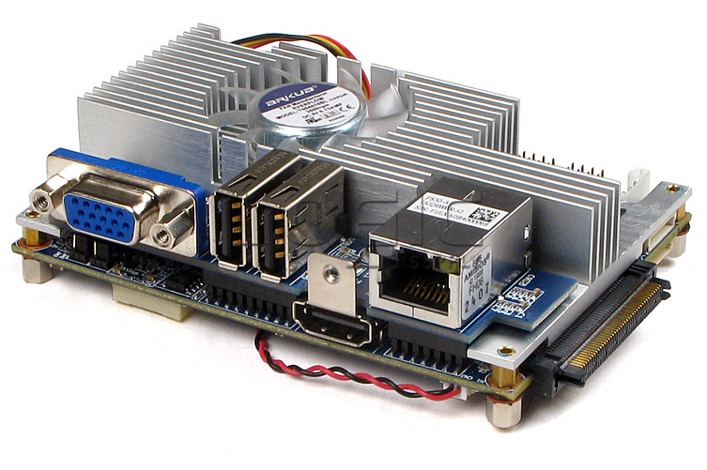
VIA EPIA-P830-12 Pico-ITX
1.2 GHz VIA Nano ULV Processor
Up to 4 gigs of RAM
3.9 x 2.8 inches

Slide 9


Software
OpenCV – Open Source Computer Vision
  Popular library for computer vision programming functions
  Used to manipulate and analyze
  images to extract useable information.
ROS - Robot Operating System
  Software Framework for robot applications
  “Meta-Operating System”
  “Provides hardware abstraction, device drivers, libraries, visualizers, message-passing, package management, and more.” – From the Ros.org home page.
Notes:
Smaller picture

Slide 10
Programming with OpenCV
Line Detection and Buoy Detection
  Raw Image → HSV → Threshold Functions → Noise Reduction → Canny Edge Detection→ Contour Plot → Centroid

Slide 11
Demo
http://youtu.be/hhjq54RT01I

Slide 12
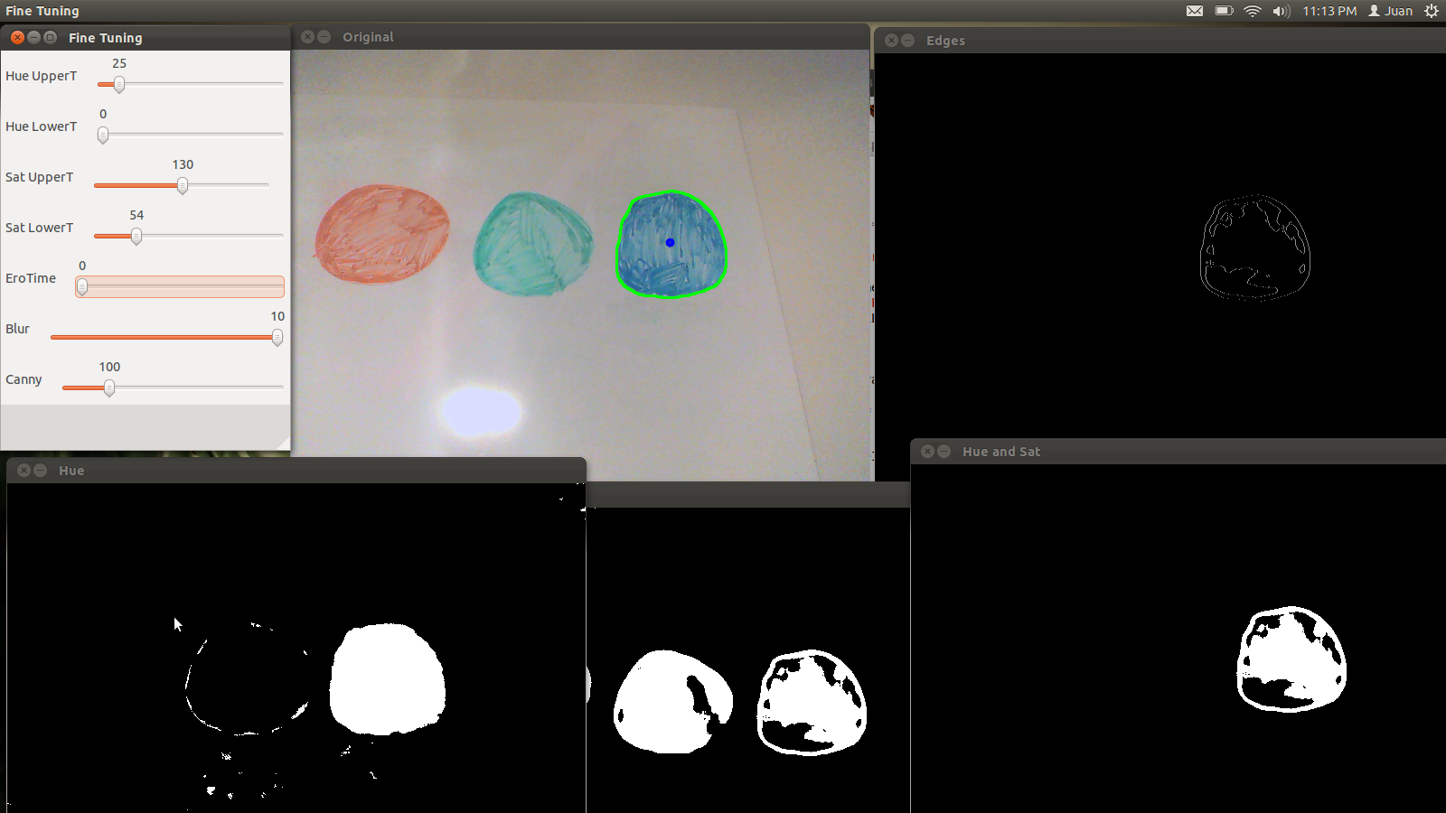
Buoy Detection by Color

Slide 13
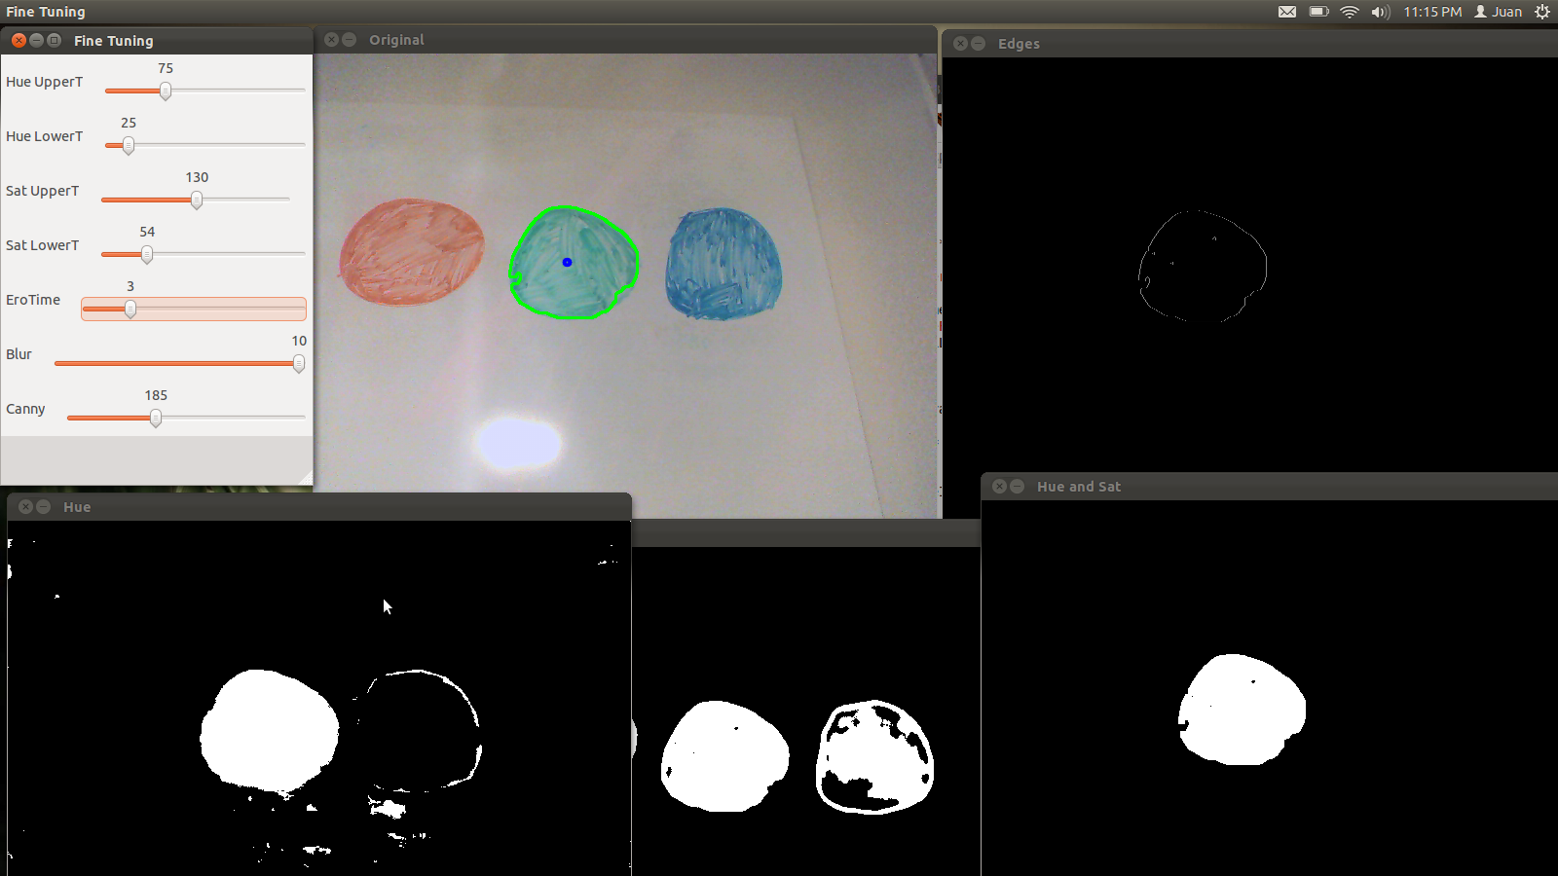
Buoy Detection by Color

Slide 14
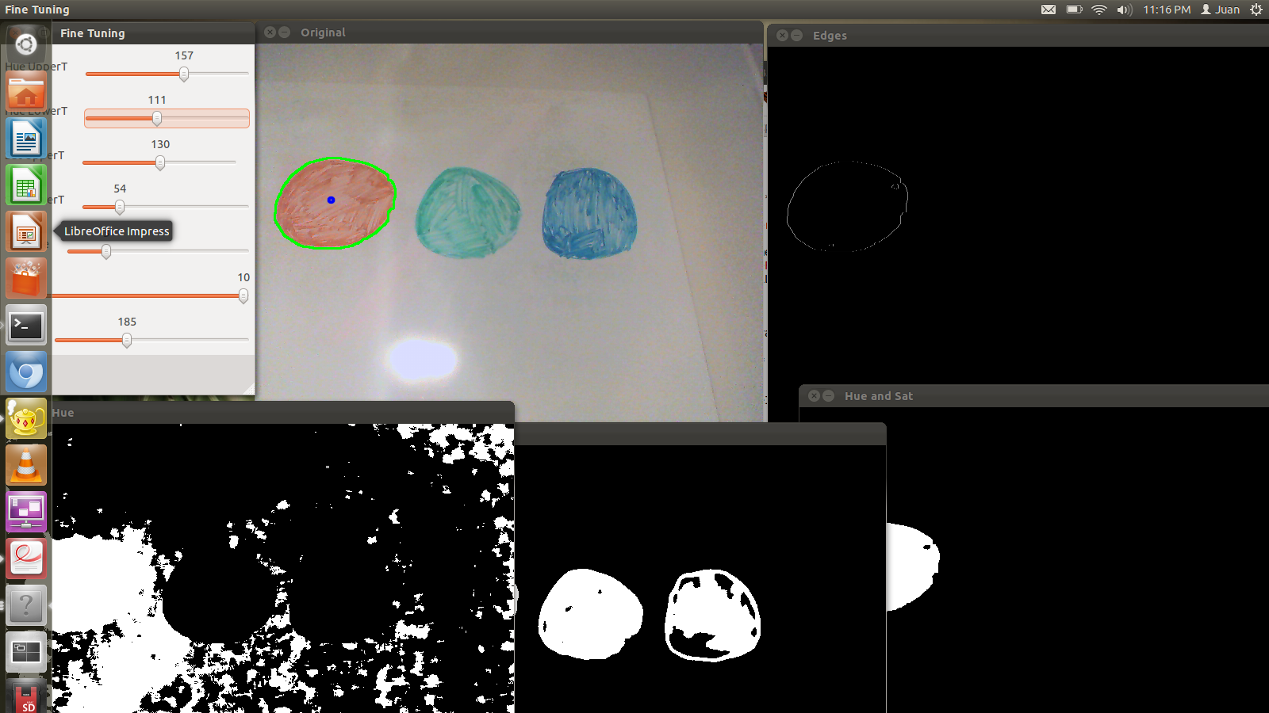
Buoy Detection by Color

Slide 15
ROS
Uses a Package system to modularize functions
Can use ROS to run multiple programs with a publisher and subscriber relationship
  For example, one ROS program, or “Node” can continuously pull frames from a camera, while another will see if and where a line exists on the frame. That node will then return the information to yet another node which will handle higher level movement and pass serial commands to another node handling the Arduino board in charge of rotors.
Notes:
Too much text. The example you gave should be in your verbal explanation. And keep in mind we’re talking to a lot of scientists… so think 8 year old kids. Of course there will be people there who do know what we’re talking about but there are going to be people who don’t know what a node is. Just food for thought, don’t play down your presentation to their level but be prepared to accommodate them.

Slide 16
Conclusion
We are building this robot to
Notes:
This should not be a listed recap of everything you just said, but rather a conclusion/summary statement. And bring it back to the competition or the point of the internship/project.

